Slide 1
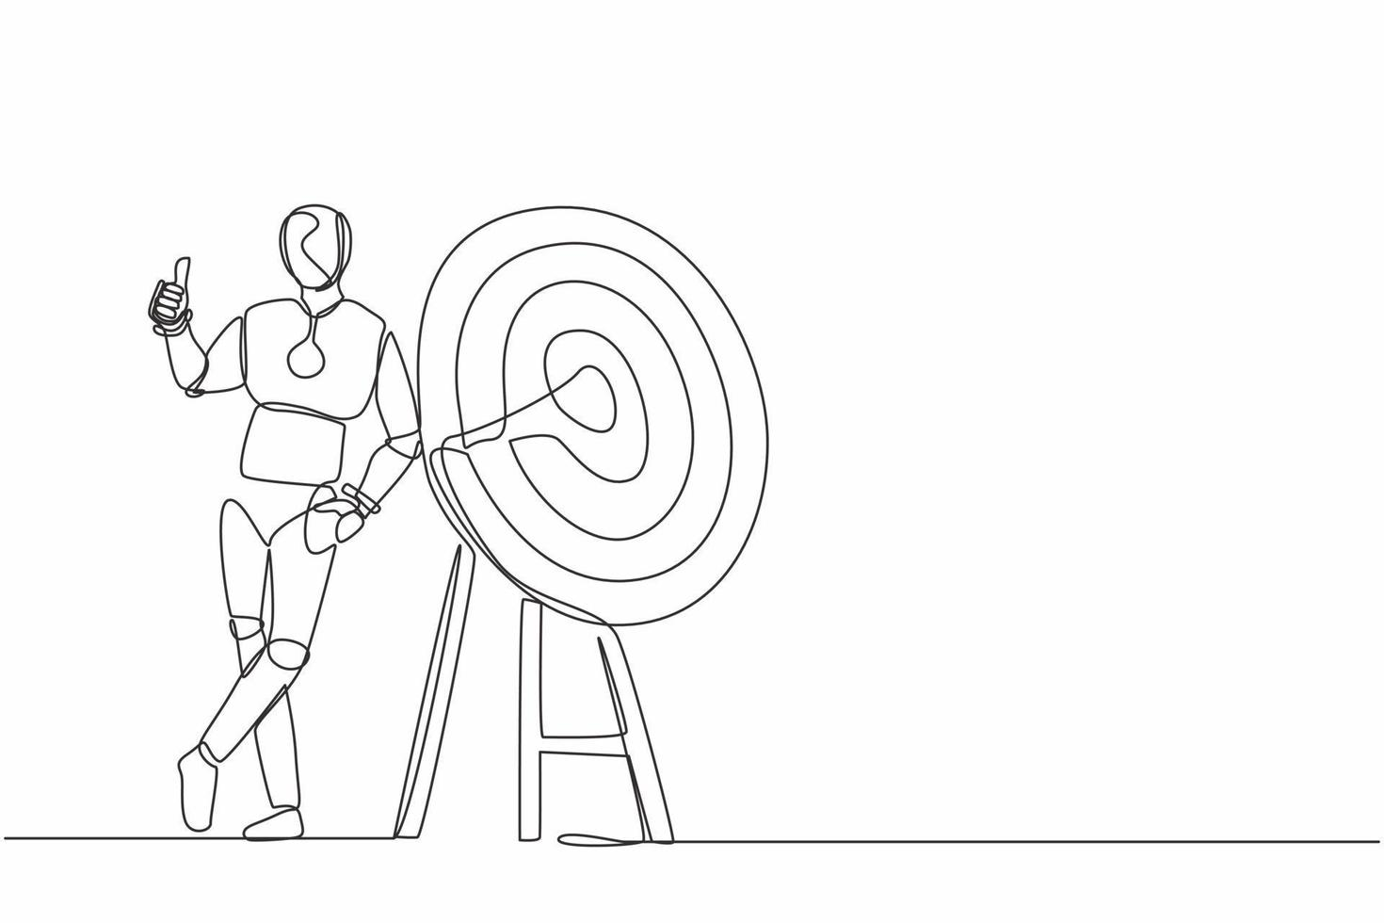
HUMANOID ROBOT
TEAM MEMBERS
ATHUL H S
HAIFA N
H SARATH
SANA JAN

Slide 2
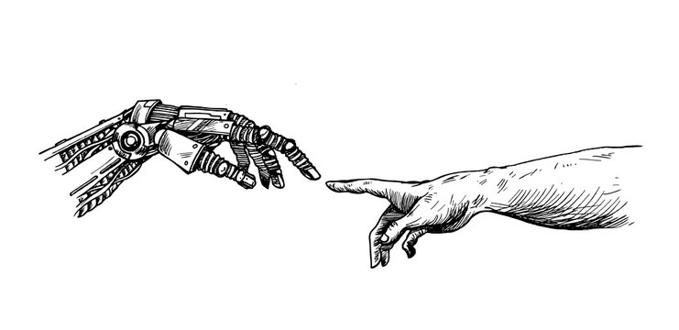
INTRODUCTION
Robotics deals with robots
Humanoid robots – recent enhancement in robotics
They having human behaviour and appearance
Body structure resembles that of a human being- head, body, legs, arms, hands

Slide 3
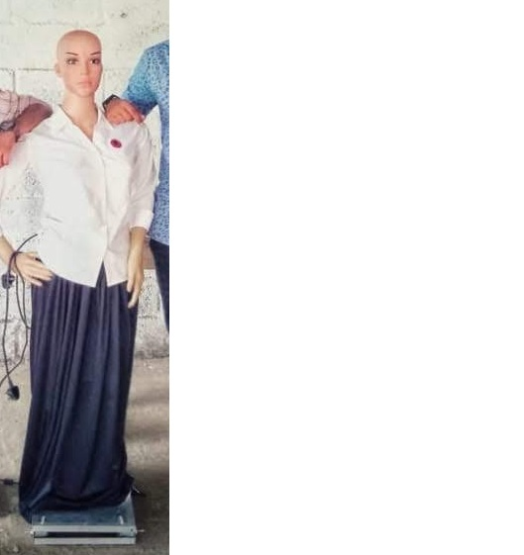
PREVIOUS TECHNOLOGY
EYRA

Slide 4

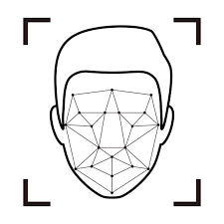
Online Speech Recognition
Face recognition
Wheeled motion

Slide 5
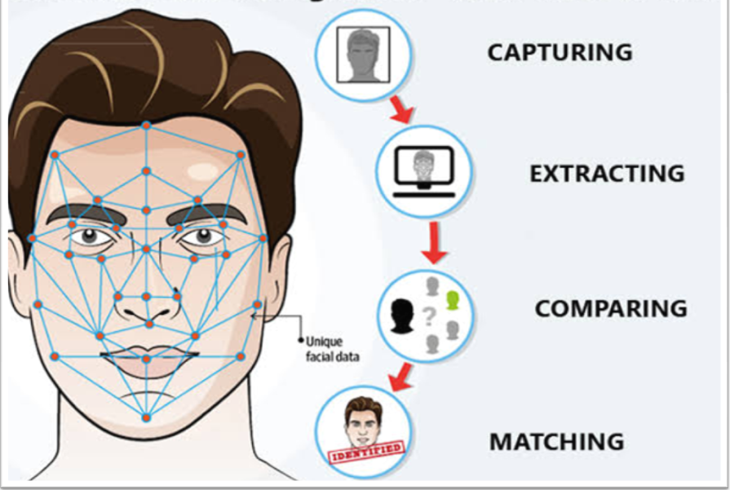
Face recognition

Slide 6
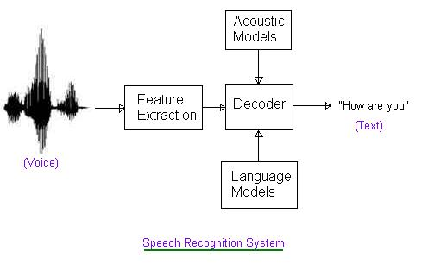
Speech recognition

Slide 7
CURRENT TECHNOLOGY
Advancement in speech recognition
Self learning
Advanced face recognition
HAAR CASCADE ALGORITHAM
Feature based object detction
Training with lots of images (+ & -)

Slide 8
Humanoid motion
IOT
3D printing
Language : python and derivate of C
Estimated cost : 40000 ( max)

Slide 9
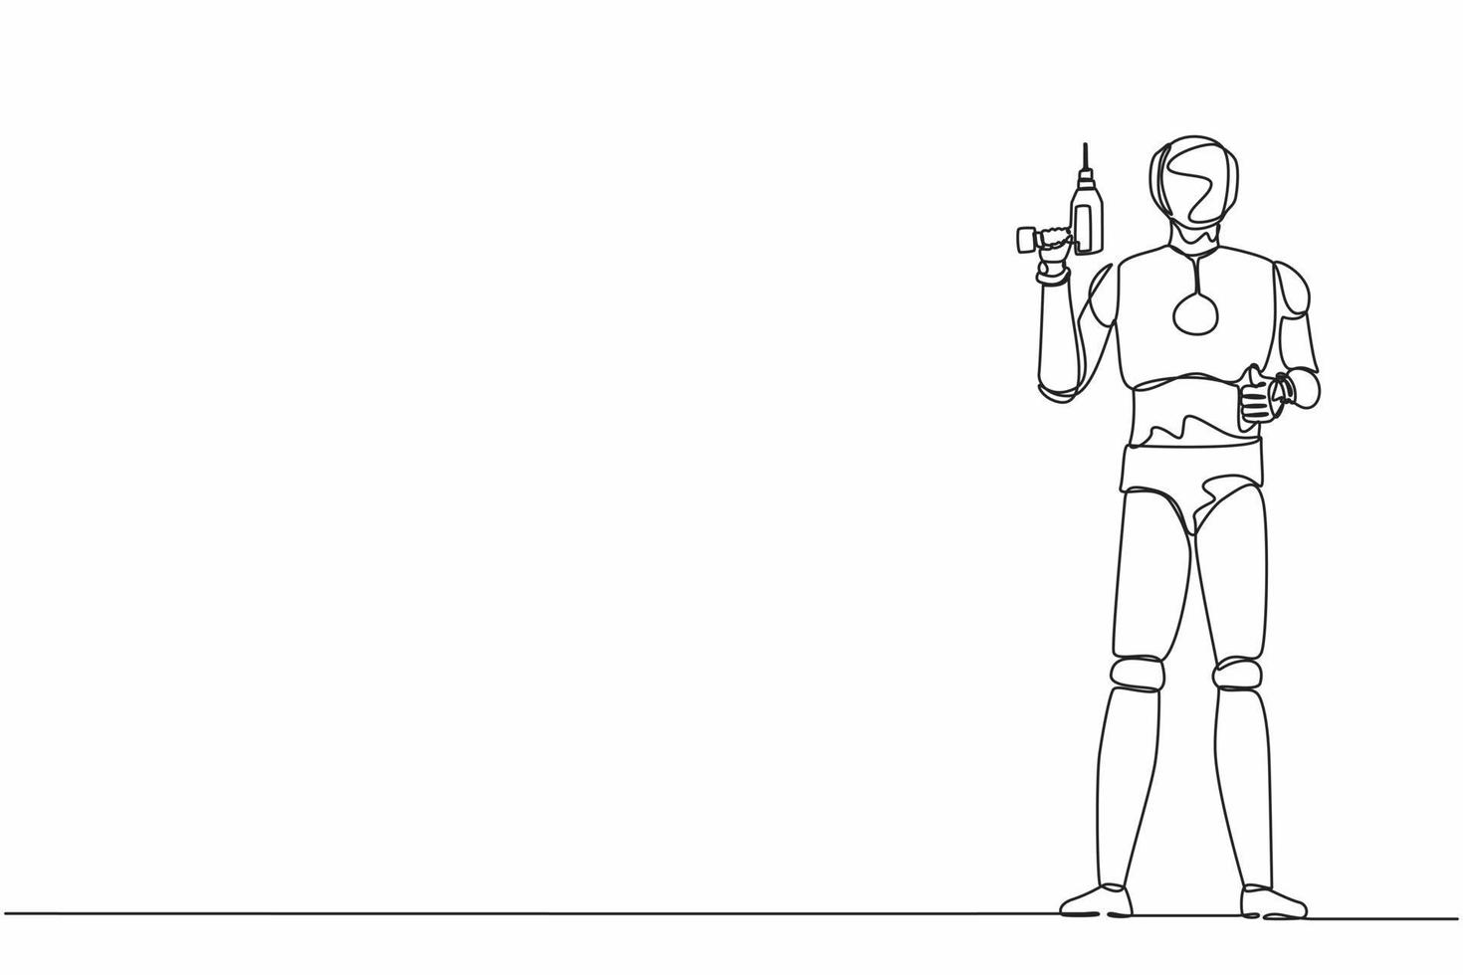
COMPONENTS
Motherboard
Arduino + nodeMCU
motor
Mic modules
Camera module
Battery

Slide 10
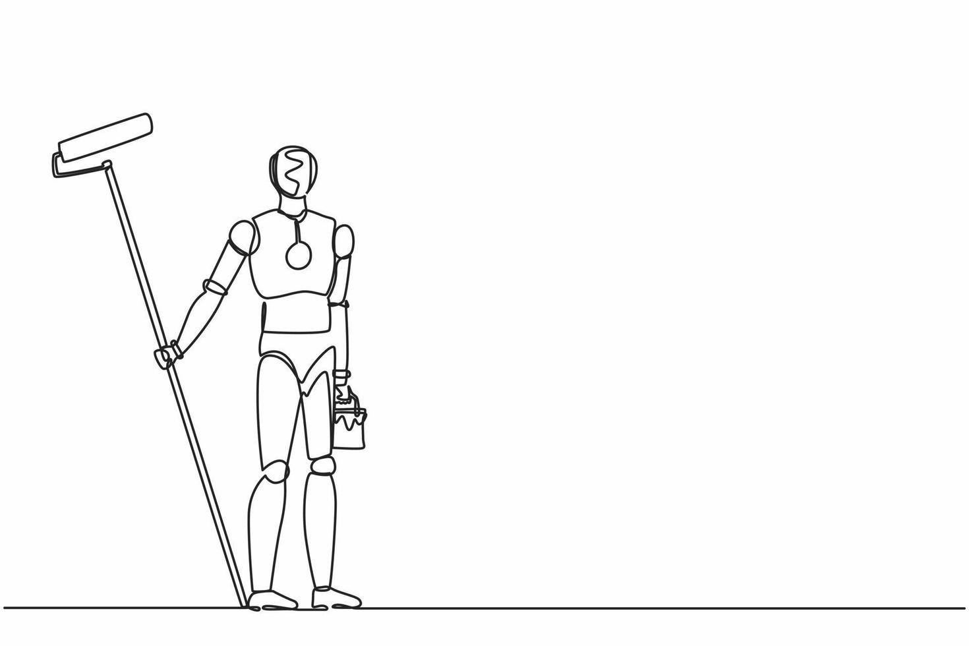
SOFTWARE
Arduino IDE
Visual studio

Slide 11
WORK STATUS
3D printed head - Assembled (6500)
Automation- IOT
Speech recognition-a capability which enables a program to process human speech into a written format and talkback(both offline and online)

Slide 12
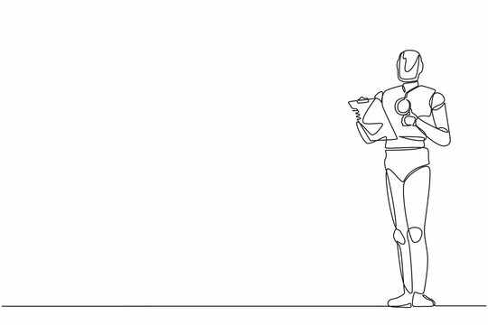
Robot base movement - Arduino + Python
Forward
Left
Right
Backward
web design

Slide 13
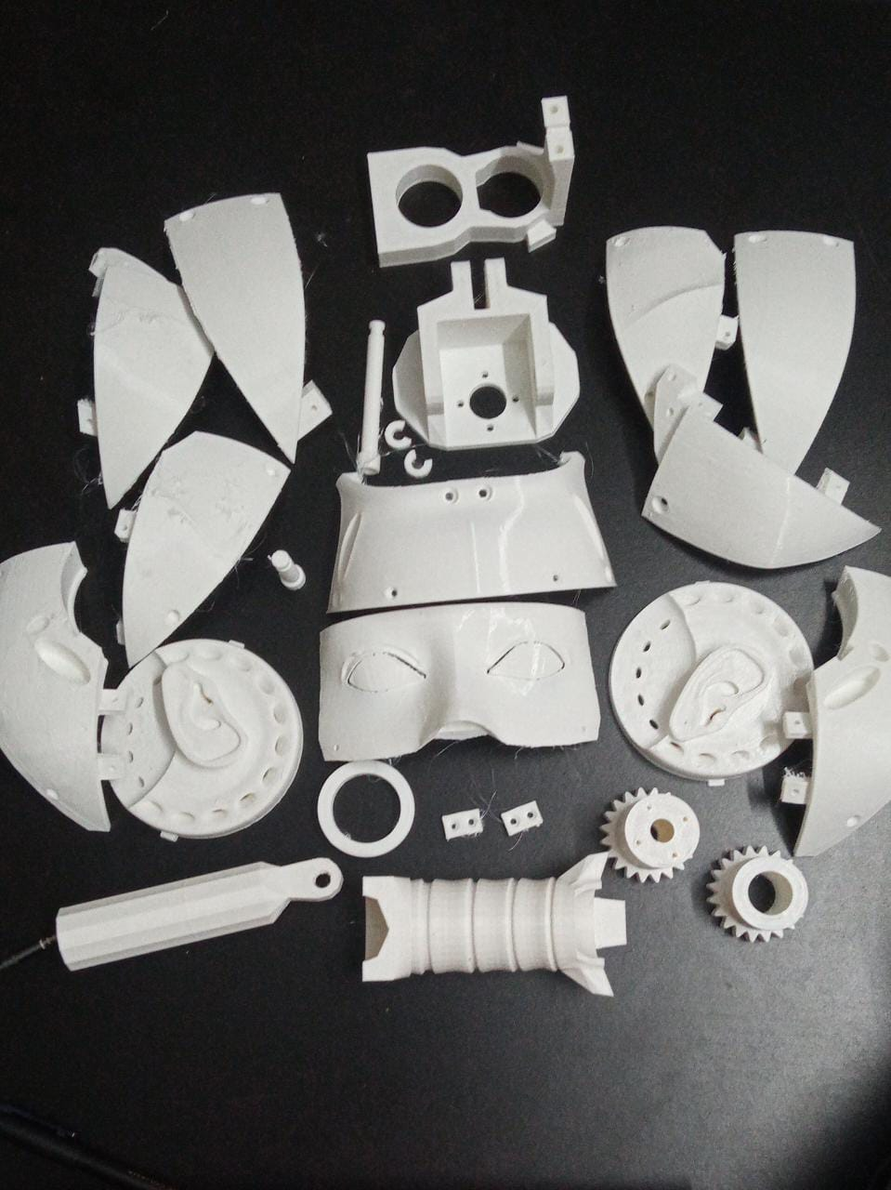
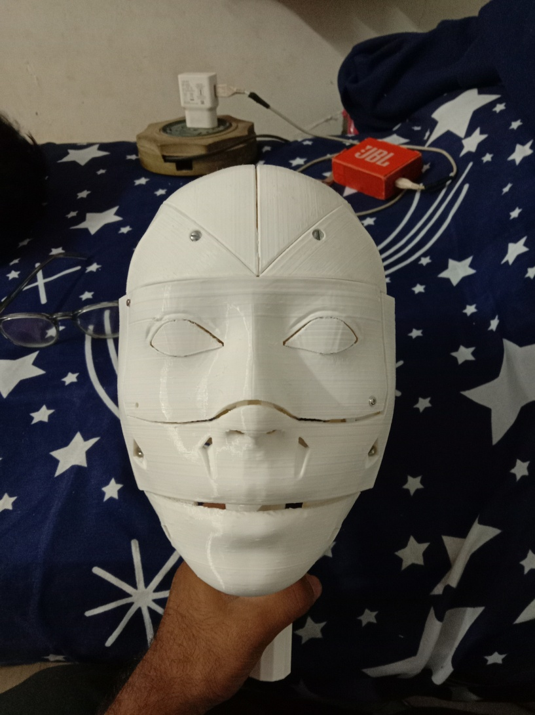
3D printed Head

Slide 14
PENDING WORK
3D printed eye- Assembling and testing (700)
Hand movement
Face recognition- dlib error solving
Setting path-Path planning lets a robot find the shortest and most obstacle-free path from a start to goal state
Many to one

Slide 15
Thank you!!

